Slide 1
Spin Hall Effect and Experimental Observation
江丙炎 1701110147@pku.edu.cn
2017.12.15

Slide 2
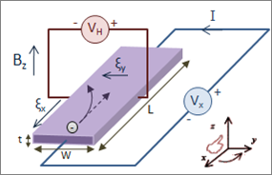
Introduction
1. Hall Effect and Anomalous Hall Effect
R
B
Fig1: Hall Effect

Slide 3
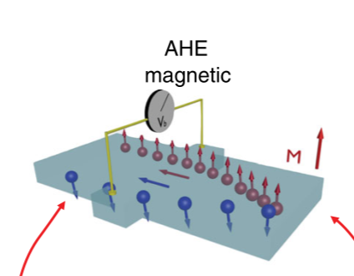
Introduction
1. Hall Effect and Anomalous Hall Effect
In ferromagnetic materials or paramagnetic materials in a magnetic field, the Hall resistivity includes an additional contribution: the anomalous Hall effect
Depend on the magnetization of the material
Often much larger than the ordinary Hall effect
Fig2: Anomalous Hall Effect
Notes:
In ferromagnetic materials (and paramagnetic materials in a magnetic field), the Hall resistivity includes an additional contribution, known as the anomalous Hall effect (or the extraordinary Hall effect), which depends directly on the magnetization of the material, and is often much larger than the ordinary Hall effect.
AHE: where relativistic spin-orbit coupling generates an asymmetric deflection of the charge carriers depending on their spin direction

Slide 4
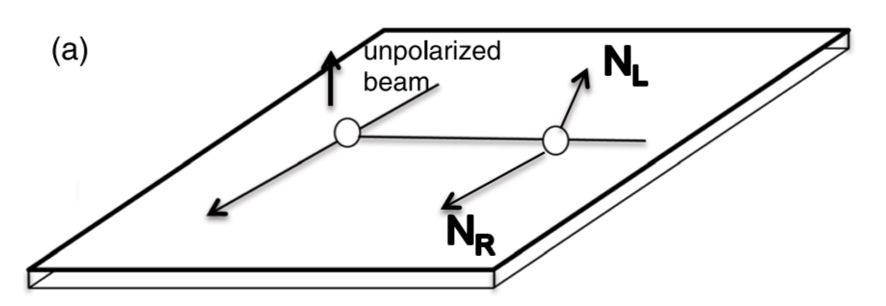
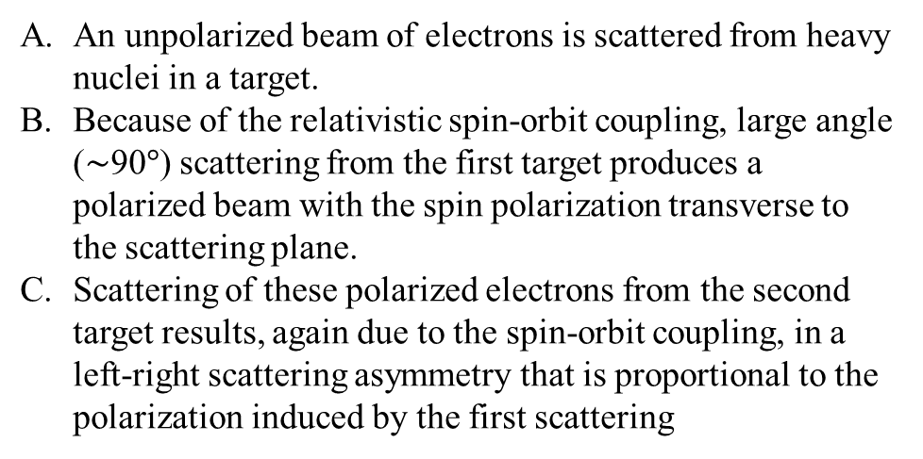
Introduction
2. Mott scattering:
An unpolarized beam of electrons is scattered from heavy nuclei in a target.
Because of the relativistic spin-orbit coupling, large angle (∼90$°$) scattering from the first target produces a polarized beam with the spin polarization transverse to the scattering plane.
Scattering of these polarized electrons from the second target results, again due to the spin-orbit coupling, in a left-right scattering asymmetry that is proportional to the polarization induced by the first scattering
Fig3: Mott double-scattering proposal

Slide 5
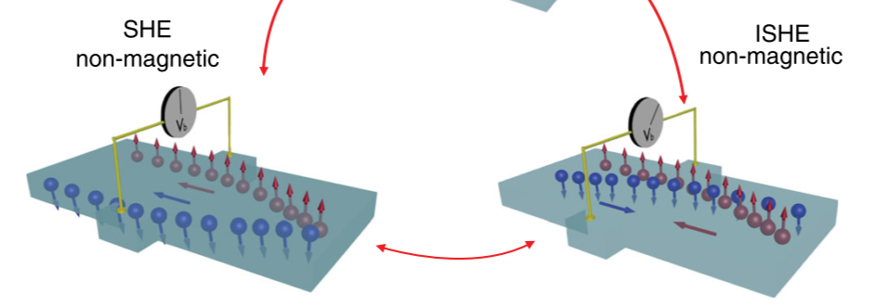
Introduction
3. Spin Hall Effect and Inverse Spin Hall Effect
The same number of spin-up and spin-down electrons, thus no transverse charge imbalance
Mott scattering of electron beams from heavy nuclei in a vacuum chamber can be regarded as the SHE in a non-solid-state environment
Fig4: Spin Hall Effect and Inverse Spin Hall Effect
Notes:
NMs in equilibrium have the same number of spin-up and spin-down electrons and no transverse charge imbalance will occur. Instead, the SHE generates an edge spin accumulation that has opposite polarization at opposite edges
Mott scattering of electron beams from heavy nuclei in a vacuum chamber can be regarded as the SHE in a non-solid-state environment
In the SHE, an unpolarized charge current generates a transverse pure spin current. In the ISHE, a pure spin current generates a transverse charge current.
of reports that

Slide 6
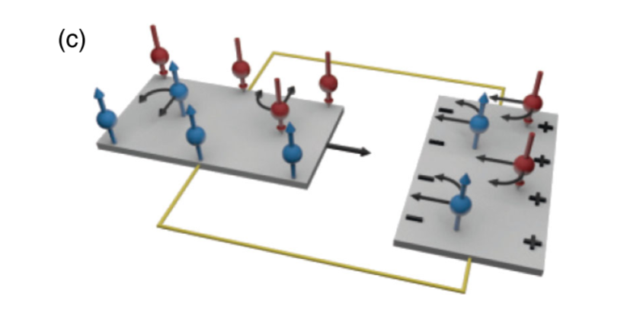
Introduction
3. Spin Hall Effect and Inverse Spin Hall Effect
The spin current is determined by the local gradient of the spin dependent chemical potentials which vanishes on the length scale given by the spin lifetime. As long as the connecting wire is longer than the characteristic spin-conserving length scale, there is no difference between a closed and an open spin-current circuit
Fig5: SHE and ISHE wired as proposed by Hirsch (1999)
Notes:
The effective spin-orbit force that deflects the spins in the SHE-ISHE is represented by straight black arrows acting on the carriers
the wires connecting the SHE and ISHE parts of Hirsch’s device have to be shorter than the characteristic spin-conserving length scale.
.In the SHE, on the other hand, the spin current in the connecting wire of Hirsch’s device is not uniform and is not determined by the difference between the spin-dependent chemical potentials at the left and right edges. It is determined by the local gradient of the spin dependent chemical potentials which vanishes (i.e., the spin current also vanishes) on the length scale given by the spin lifetime. As long as the connecting wire is longer than the characteristic spin-conserving length scale, there is no difference between a closed and an open spin-current circuit.

Slide 7
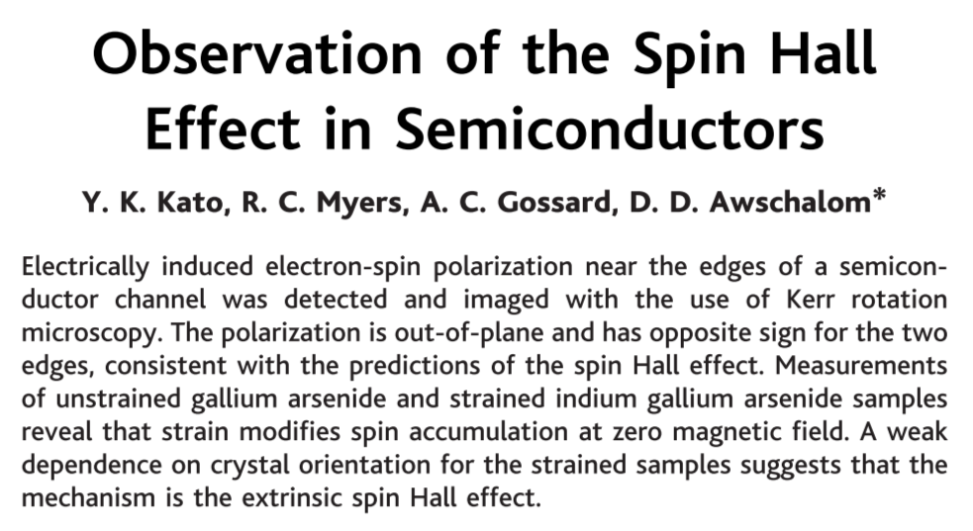
Experiments
Science 306 , 1910 (2004)
Optical detection of the spin Hall effect in thin films of the semiconductor GaAs and InGaAs.
Scanning Kerr rotation measurements show the presence of electron spin accumulation at the edges of the samples, consistent with the prediction of a spin current transverse to the applied electric field.
We investigated the effect in both unstrained and strained samples and found that an applied in-plane magnetic field can play a critical role in the appearance of the spin accumulation.

Slide 8
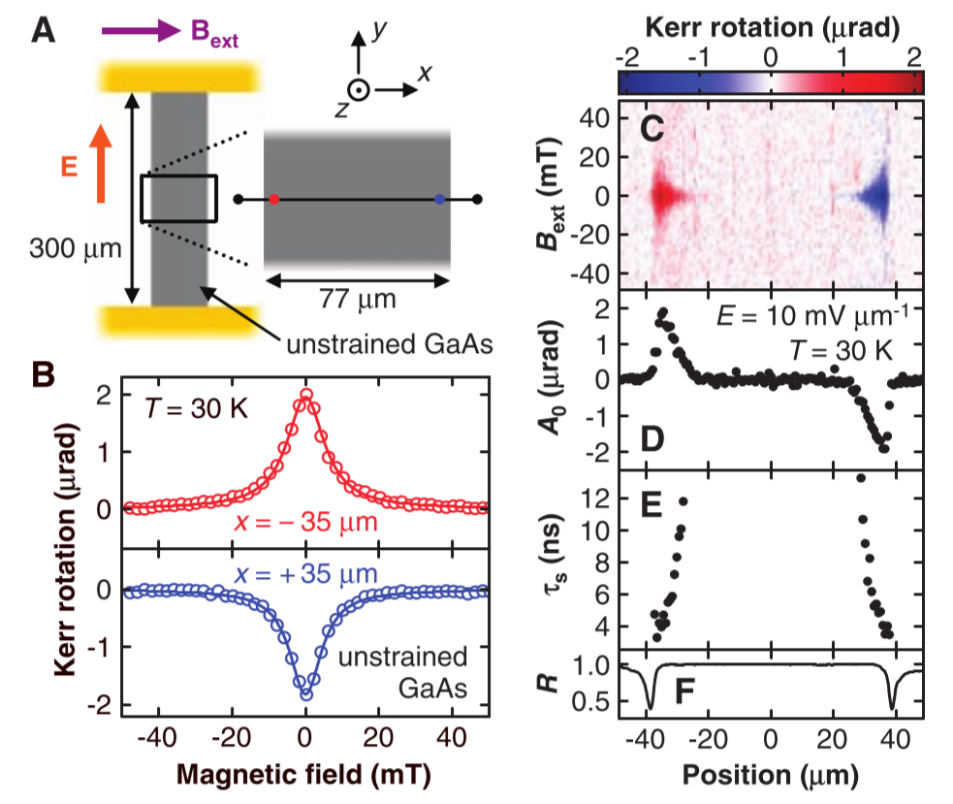
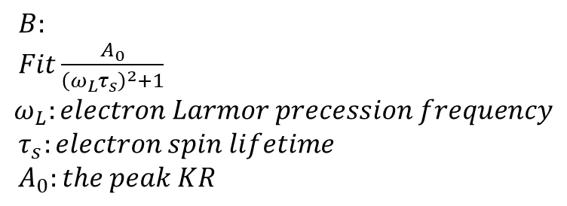
Experiments
$B:$
$Fit\frac{A_{0}}{{\left(ω_{L}τ_{s}\right)}^{2}+1}$
$$ω_{L}:electron Larmor precession frequency$$
$τ_{s}:electron spin lifetime$
$A_{0}:the peak KR$
The Hanle effect: spin precession
Notes:
The spin Hall effect in unstrained GaAs. Data are taken at T 0 30 K; a linear background has been subtracted from each Bext scan.
Schematic of the unstrained GaAs sample and the experimental geometry.
(B) Typical measurement of KR as a function of Bext for x 0 –35 mm (red circles) and x 0 35 mm (blue circles) for E 0 10 mV mm–1. Solid lines are fits as explained in text.
(C) KR as a function of x and Bext for E 0 10 mV mm–1.
(D and E) Spatial dependence of peak KR A0 and spin lifetime ts across the channel, respectively, obtained from fits to data in (C).
(F) Reflectivity R as a function of x. R is normalized to the value on the GaAs channel. The two dips indicate the position of the edges and the width of the dips gives an approximate spatial resolution.
(G) KR as a function of E and Bext at x 0 –35 mm. (H and I) E dependence of A0 and ts, respectively, obtained from fits to data in (G).

Slide 9
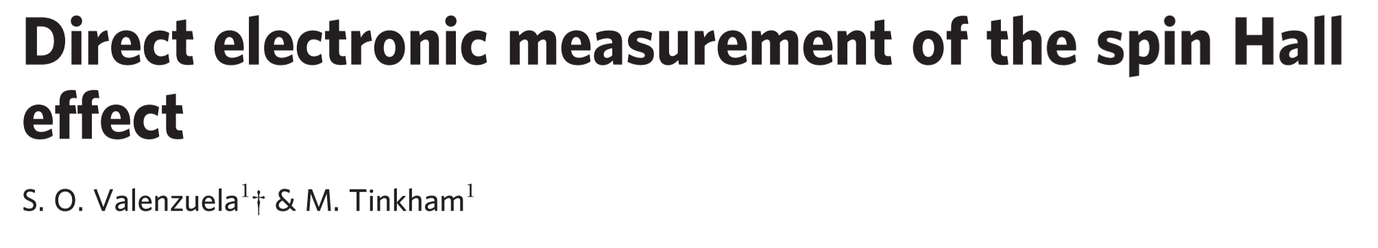
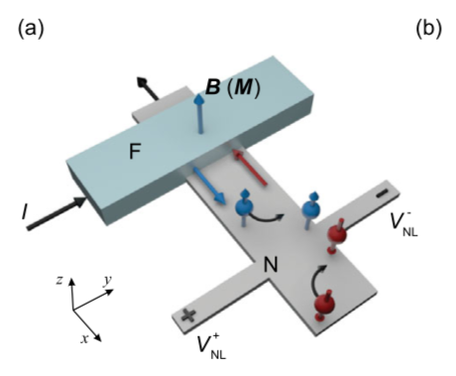
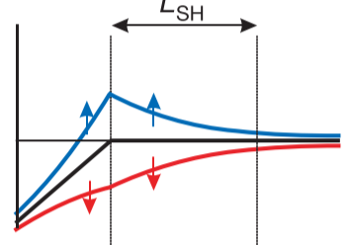

Experiments
Vol 442|13 July 2006|doi:10.1038/nature04937
$${μ_{↑}}_{↓}$$
Notes:
the current is drained to the left of NM, there is no charge current toward the right;

Slide 10
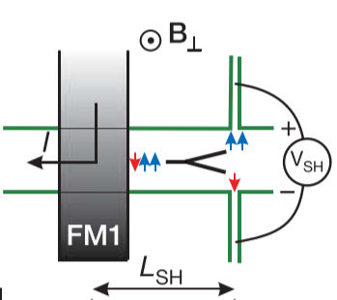
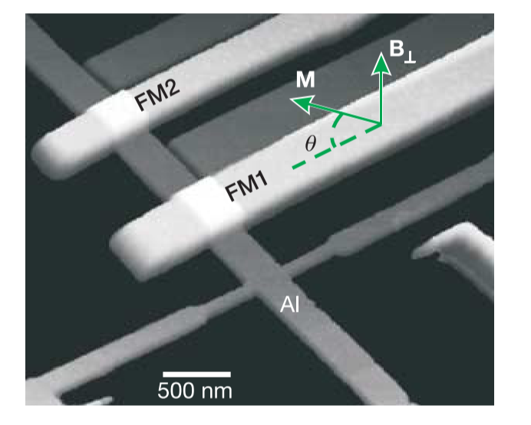
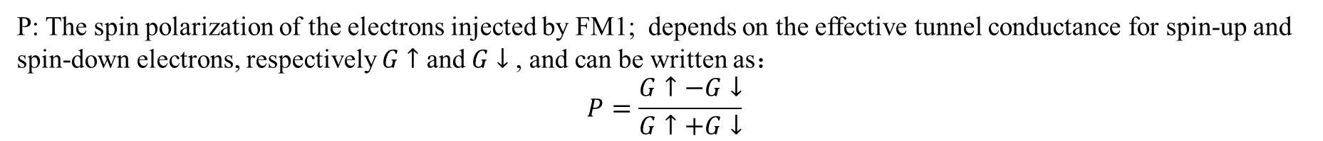
Experiments
$V_{SH}$ are expected to be proportional to P and to decay with spin diffusion length $λ_{sf}$
$$V_{SH}∝\vec{σ}×\vec{E^{σ}}∝sinθ,\vec{E^{σ}}=−∇μ^{σ}(r)$$
P: The spin polarization of the electrons injected by FM1; depends on the effective tunnel conductance for spin-up and spin-down electrons, respectively $G↑$ and $G↓$, and can be written as：
$$P=\frac{G↑−G↓}{G↑+G↓}$$

Slide 11
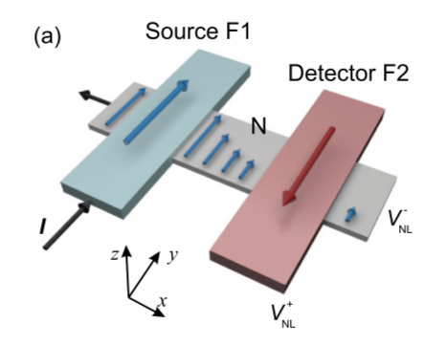
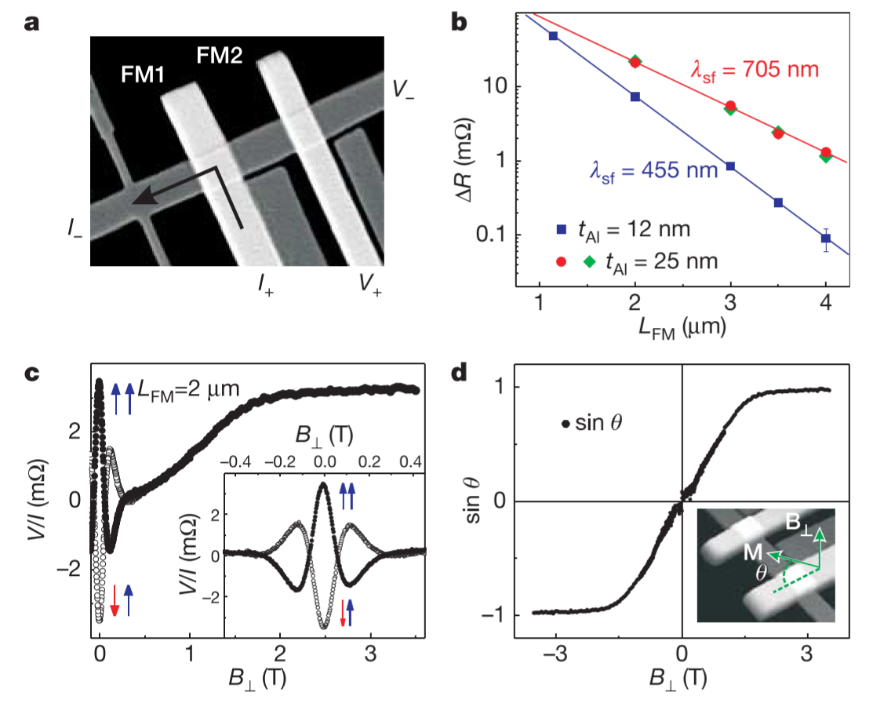
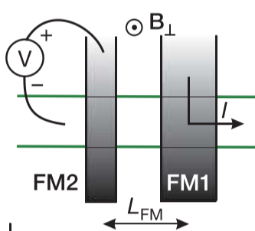
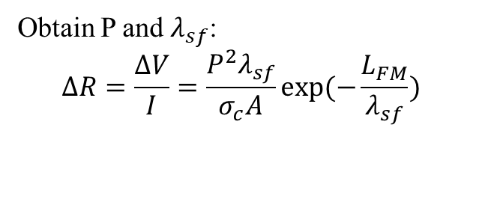
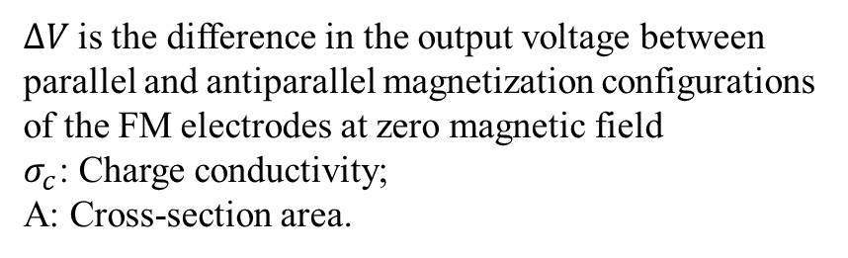
Experiments
P=0.28
Obtain P and $λ_{sf}$:
$$ΔR=\frac{ΔV}{I}=\frac{P^{2}λ_{sf}}{σ_{c}A}exp⁡(−\frac{L_{FM}}{λ_{sf}})$$
$ΔV$is the difference in the output voltage between parallel and antiparallel magnetization configurations of the FM electrodes at zero magnetic field
$σ_{c}$: Charge conductivity;
A: Cross-section area.

Slide 12
Experiments
Small B: the measurements show the Hanle effect associated with precessing spins.
As B increases, the magnetizations tilt out of plane.
For large enough B, they orient completely along the field and the measurements saturate to a positive constant value.
Calculate $θ$: At B=0, $V_{±}∝±f\left(B\right)\cos^{2}{θ+\sin^{2}{θ}}$, thus $V_{+}+V_{−}∝2\sin^{2}{θ}$
At $B\sim 1.55T$ $sinθ \sim 1$

Slide 13
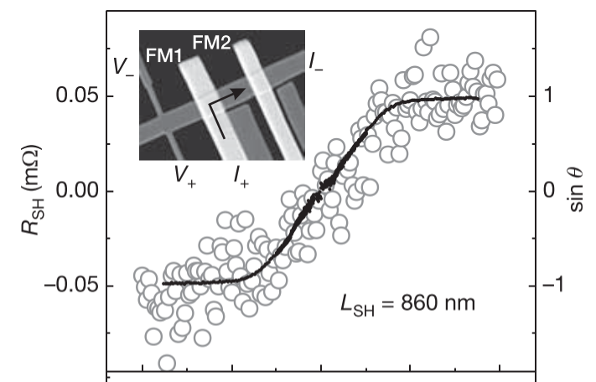
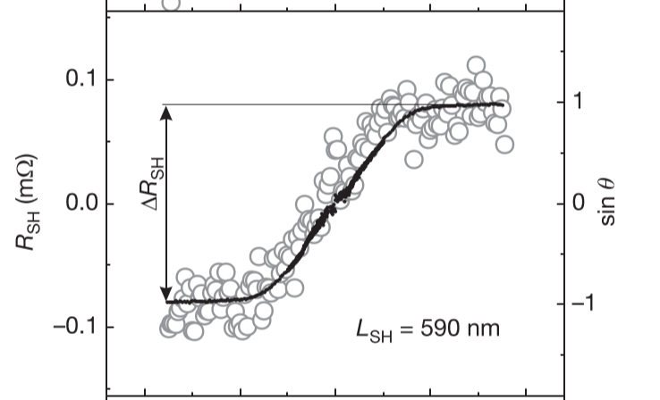
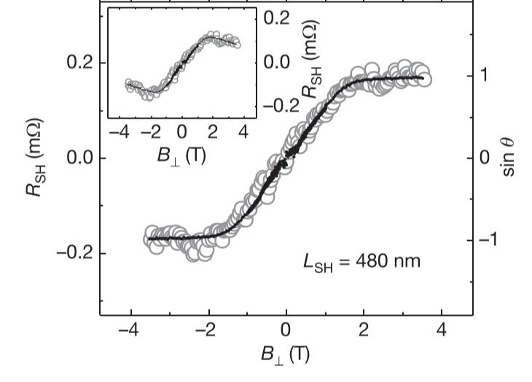
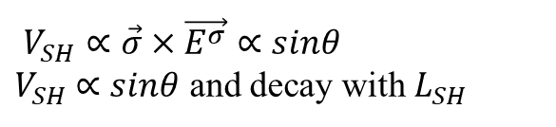
Experiments
$V_{SH}∝\vec{σ}×\vec{E^{σ}}∝sinθ$
$V_{SH}$ $∝sinθ$ and decay with $L_{SH}$

Slide 14
Summary
1. Brief introduction to Spin Hall Effect and Inverse Spin Hall Effect
2. Optical detection of the spin Hall effect
3. Electronic measurement of the spin Hall effect

Slide 15
Thanks!

Slide 16
Reference
[1]. Jairo Sinova, Sergio O. Valenzuela, J. Wunderlich, etal. Spin Hall Effect. REVIEWS OF MODERN PHYSICS, 2015, 87(4): 1213-1247

